Slide 1
DevOps Training Assignment 2
Create EC2 instances
Create one Windows Instance in Public Subnet and connect.
Create one Linux Instance in Public Subnet and connect.
Create one Linux Instance in Private Subnet and connect.
Provide screenshots for everything.

Slide 2
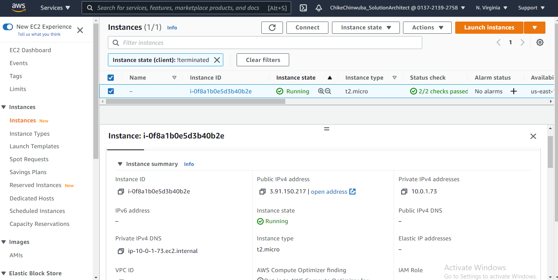
Linux EC2 Server running

Slide 3
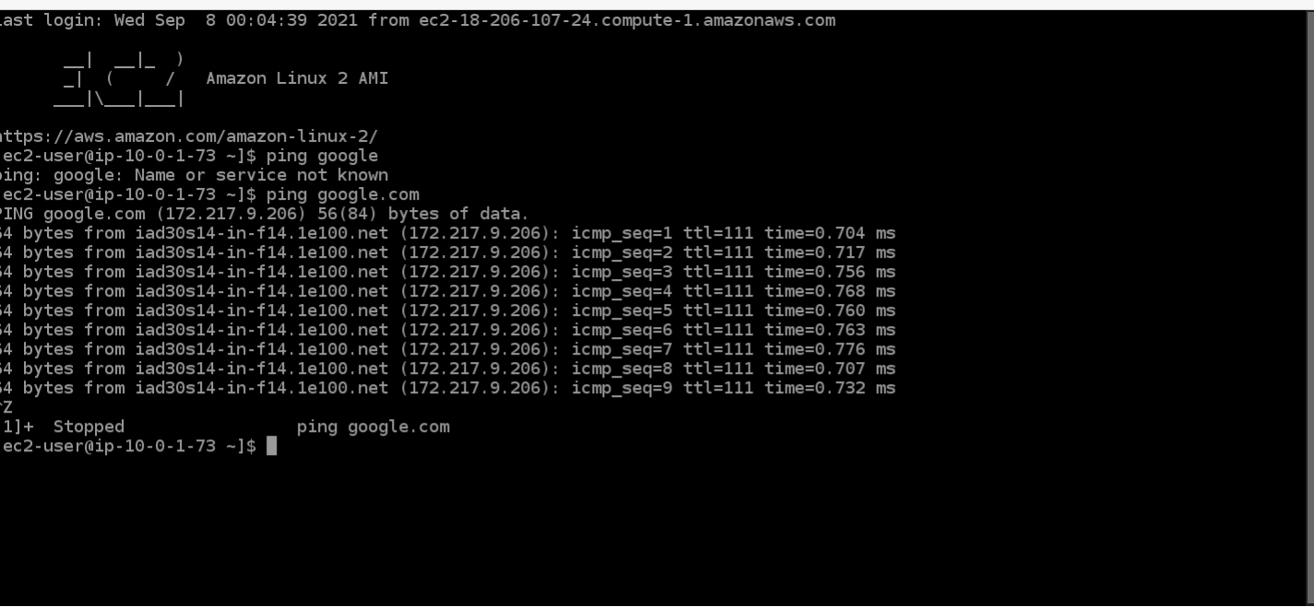
Linux EC2 server connected

Slide 4
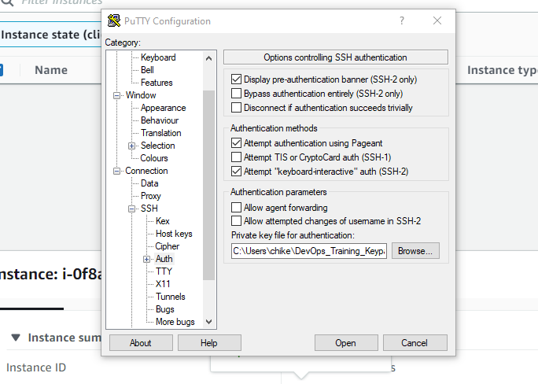
Converting Key pairs from .pem to .ppk using Putty

Slide 5

Connecting to Internet using Putty

Slide 6
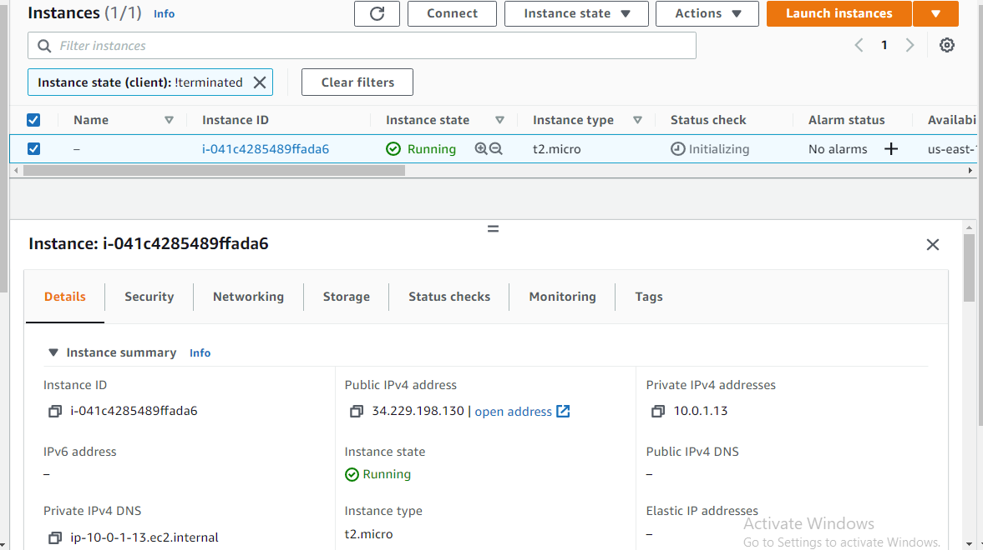
Windows Server - 1

Slide 7
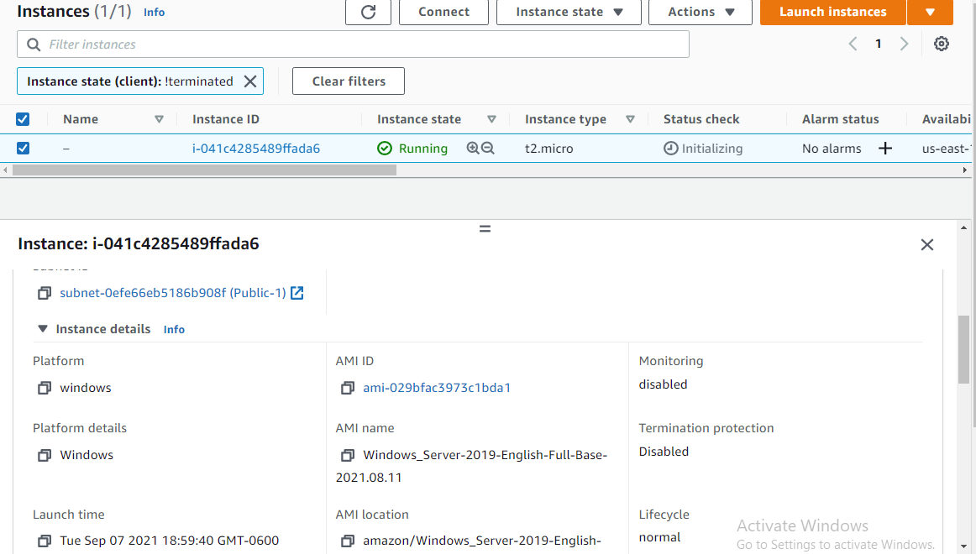
Windows Server - 2

Slide 8
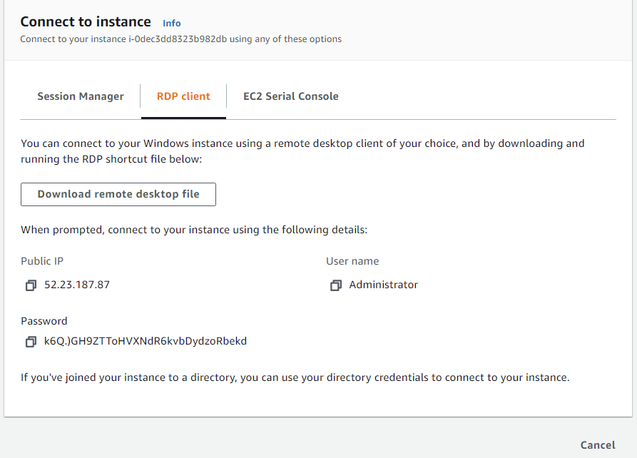
Windows Passwd

Slide 9
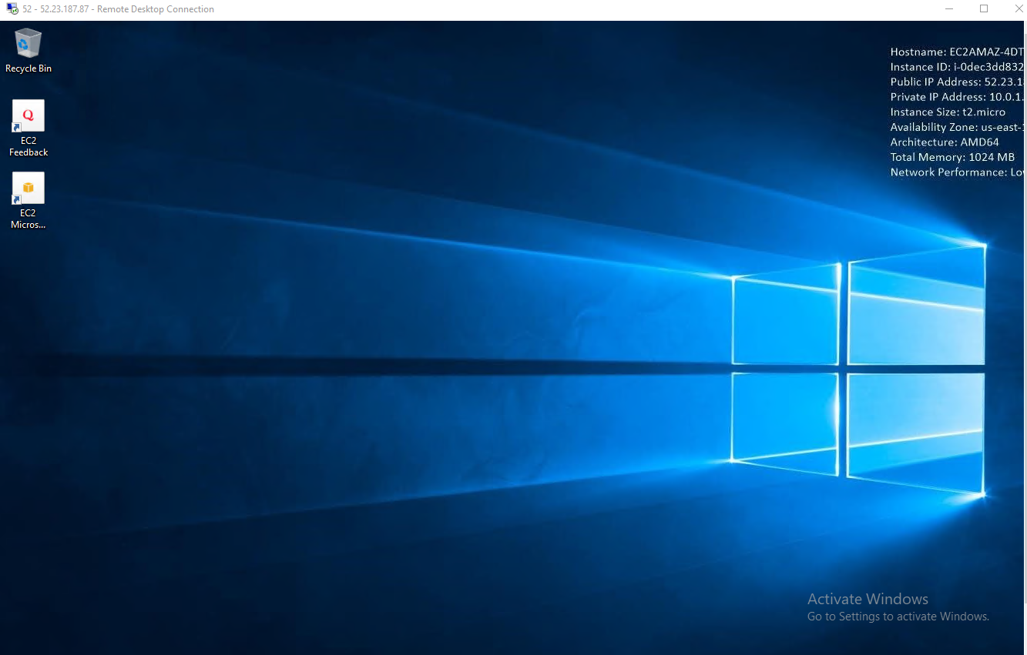
Windows Remote Connection

